Slide 1
BD LAB INTERNAL
PRATIK D. NALAWADE
1NT18IS115
batch b2
SEC B

Slide 2
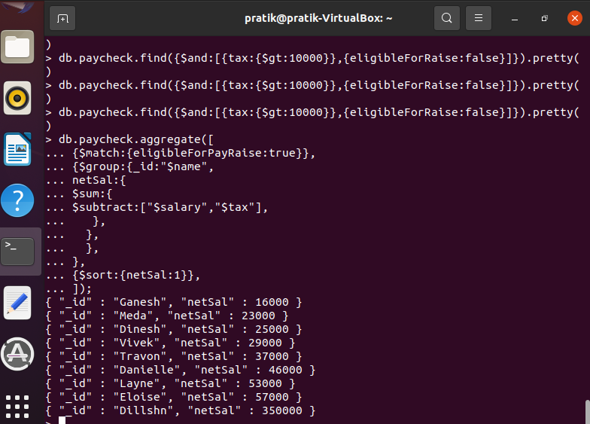
Demonstrate the usage of $match, $group, aggregate pipelines.
$match: used to match a specific condition
$group: groups based on clause

Slide 3

Demonstrate the Map-Reduce aggregate function on this dataset.

Slide 4

Find out all the Employees, who are paying tax>10000 and are not eligible for pay raise.

Slide 5
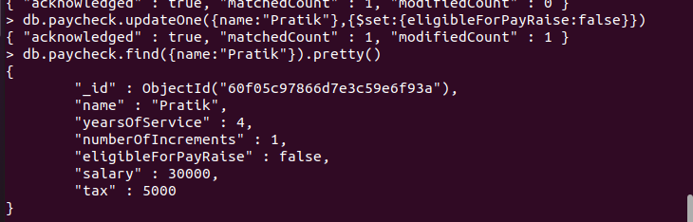
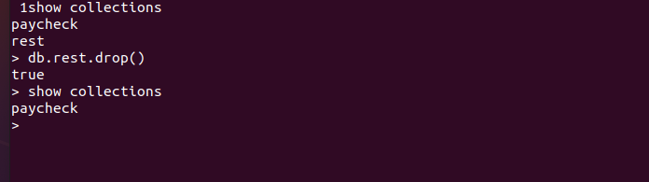
Demonstrate the Alter and Drop commands on this dataset.

